Slide 1
Chapter 26.
Remote Logging, Electronic Mail and File Transfer
Computer Networks
26-<number>

Slide 2
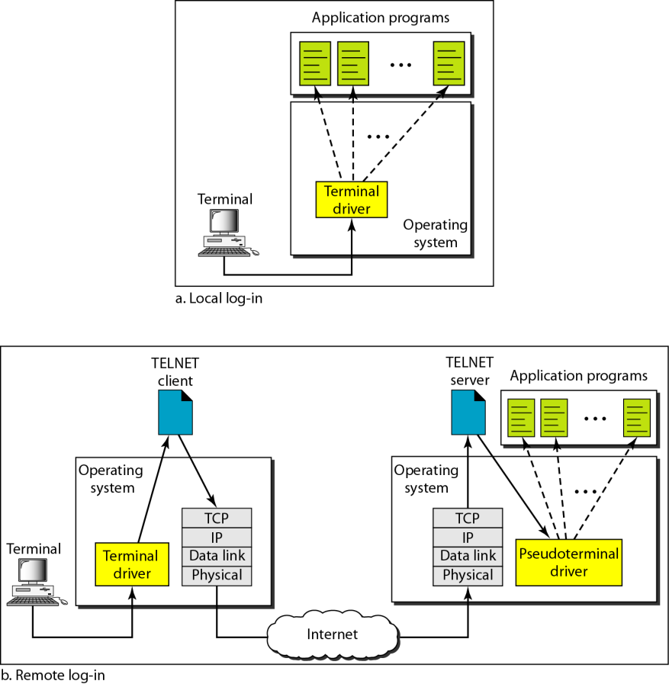
Remote Logging
TELNET is a general-purpose client/server application program
Computer Networks
26-<number>

Slide 3
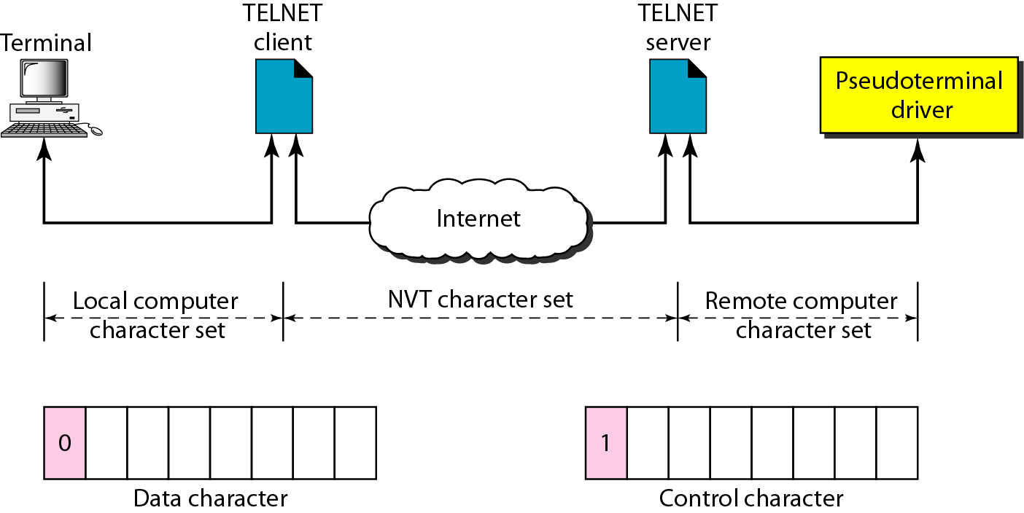
Network Virtual Terminal
Computer Networks
26-<number>

Slide 4


Electronic Mail (1,2)
When the sender and the receiver of an e-mail are on the same system, we need only two user agents.
When the sender and the receiver of an e-mail are on different systems, we need two UAs and a pair of MTAs (client and server).
Computer Networks
26-<number>

Slide 5

Electronic Mail (3)
When the sender is connected to the mail server via a LAN or a WAN, we need two UAs and two pairs of MTAs (client and server).
Computer Networks
26-<number>

Slide 6

Electronic Mail (4)
When both sender and receiver are connected to the mail server via a LAN or a WAN, we need two UAs, two pairs of MTAs and a pair of MAAs. This is the most common situation today.
Computer Networks
26-<number>

Slide 7

User Agent
Services provided by a user agent
Command-driven user agents: mail, pine, and elm.
GUI-based user agents: Eudora, Outlook, and Netscape.
Computer Networks
26-<number>

Slide 8

Format of an E-mail
Computer Networks
26-<number>

Slide 9

Email address
The local port defines the name of a special file, called the user mailbox, where all the mail received for a user is stored for retrieval by the user agent
Computer Networks
26-<number>

Slide 10
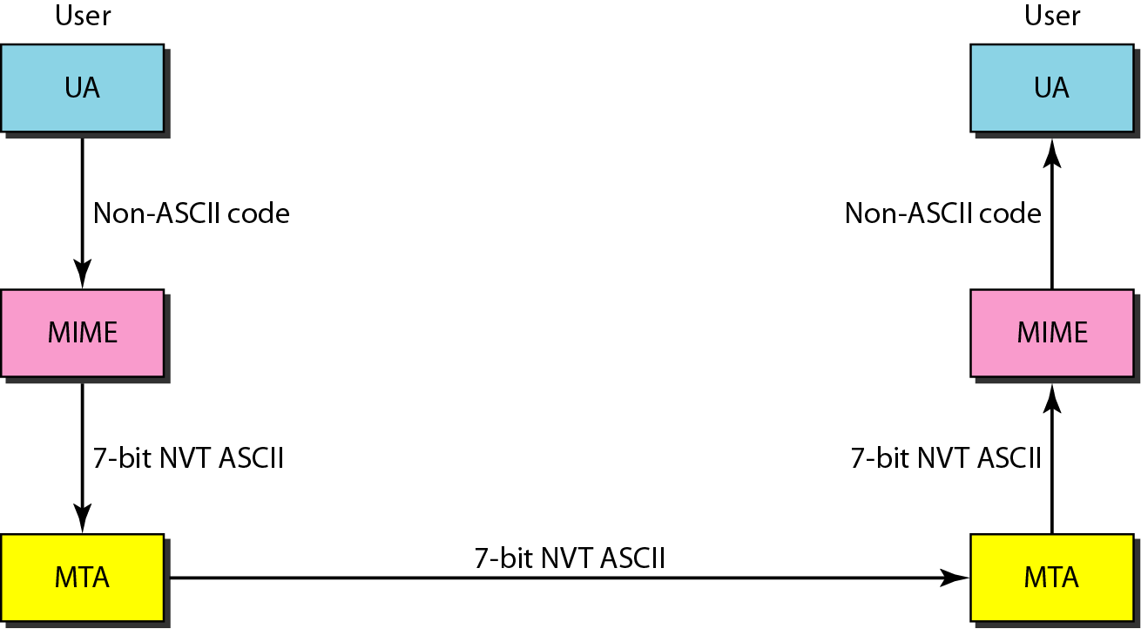
MIME
Multipurpose Internet mail Extensions (MIME)
Supplementary protocol that allows non-ASCII data to be sent through SMTP
Computer Networks
26-<number>

Slide 11
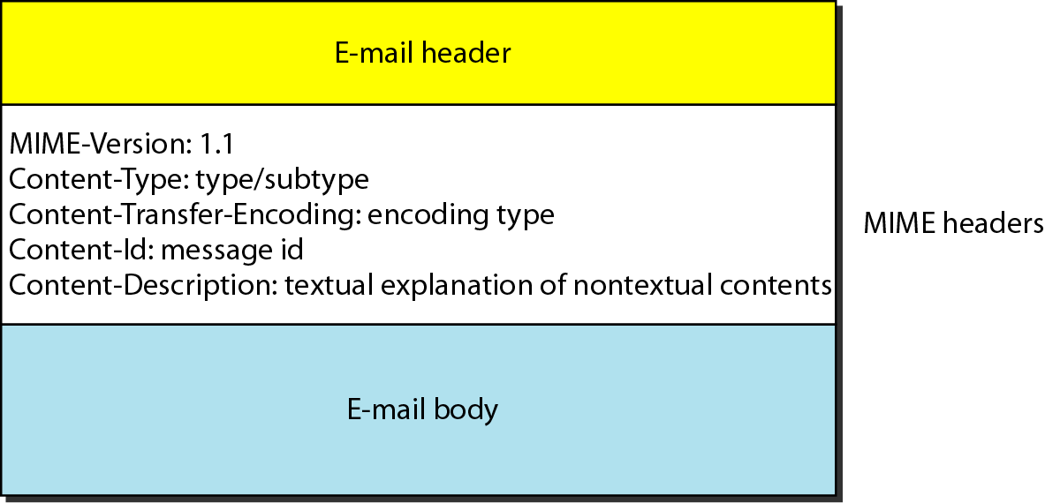
MIME Header
To transform non-ASCII data to ASCII data
Computer Networks
26-<number>

Slide 12
Data Types in MIME
Computer Networks
26-<number>

Slide 13
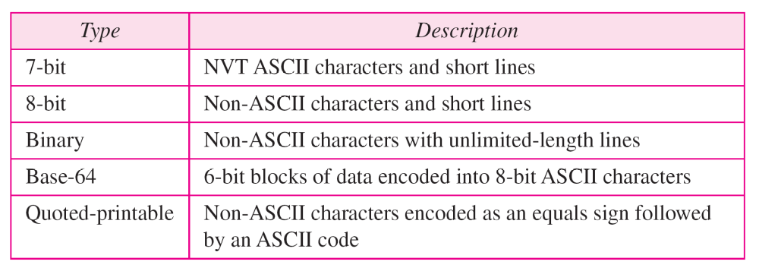
Content-Transfer-Encoding
Computer Networks
26-<number>

Slide 14
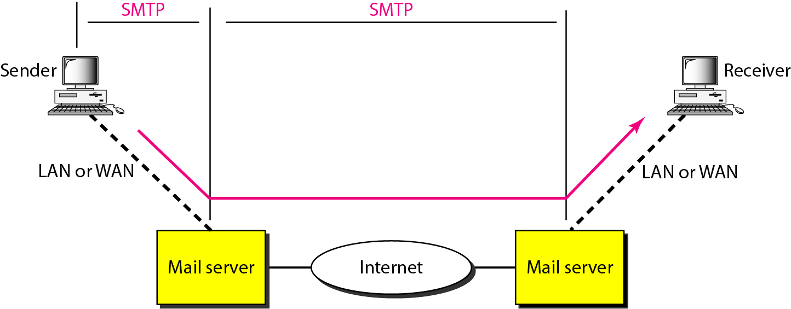
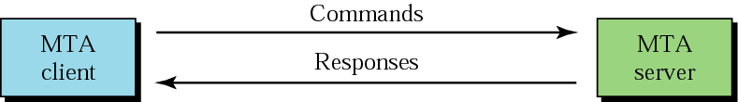
Mail Transfer Agent (MTA): SMTP
The actual mail transfer is done through MTA
Computer Networks
26-<number>

Slide 15
Mail Access Agent: POP and IMAP
The third stage: pull protocol (SMTP is a push protocol for the first/second stages)
Two mail access protocols
  Post Office Protocol, version 3 (POP3)
  Internet Mail Access Protocol, version 4 (IMAP4)
POP3 is simple and limited in functionality
IMAP4 is similar to POP3, but has more features with extra functions
  A user can check the email header prior to downloading
  A user can search the contents of the email for a specific string of characters prior to downloading
  A user can create, delete, or rename mailboxes on the mail server
  A user can create a hierarchy of mailboxes in a folder for email storage
Computer Networks
26-<number>

Slide 16
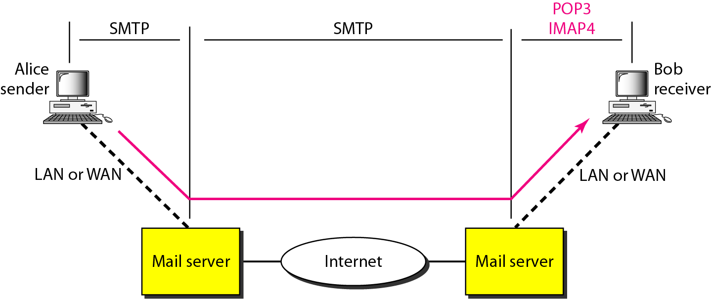
POP3 and IMAP4
Computer Networks
26-<number>

Slide 17
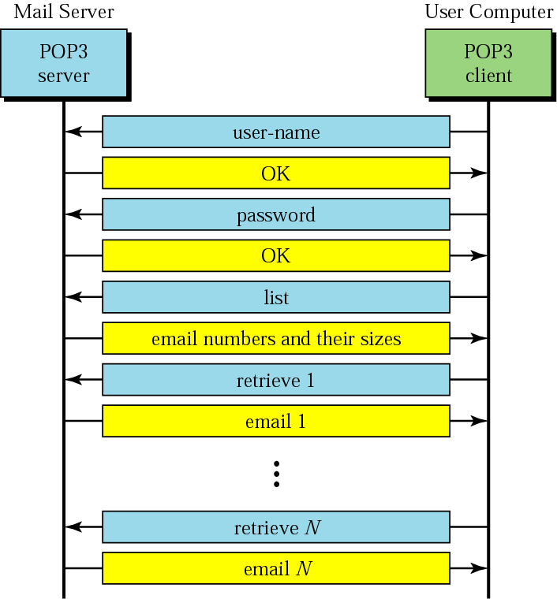
POP3
Computer Networks
26-<number>

Slide 18
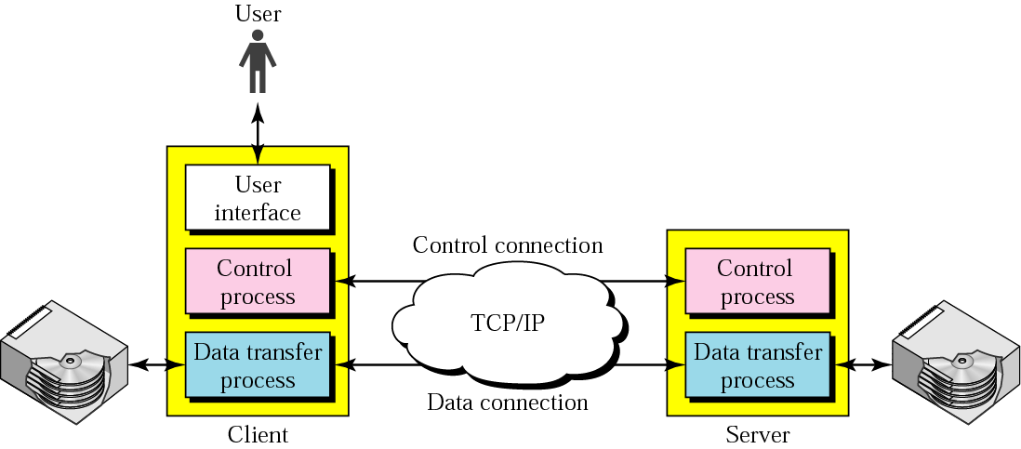
File Transfer
FTP uses the services of TCP. It needs two TCP connections. The well-known port 21 is used for the control connection, and the well-known port 20 is used for the data connection.
Computer Networks
26-<number>

Slide 19
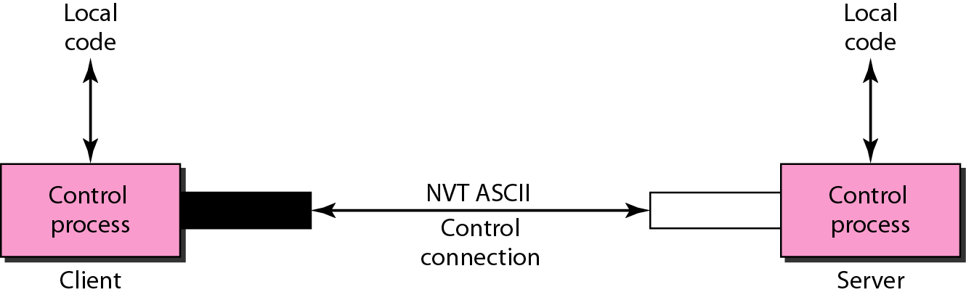
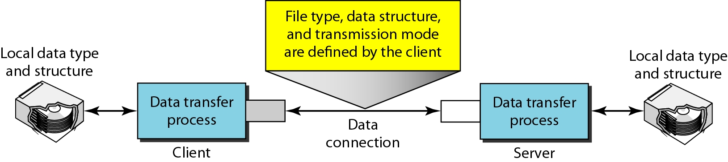
Communication over Two Connections
Computer Networks
26-<number>

